Slide 1
LIDB

Slide 2
LIDB
LIDB stands for Line Information Database.
The Line Information Databases contains subscriber information such as a service profile, 10-digit line numbers, service provider ID, equipment indicator, and billing specifications.
  Positive database
    Contains only working numbers
  Almost all working numbers are stored in LIDB
  LIDB data sets are:
    Telephone Number
    Class of Service (business, residential, prepaid, postpaid, coinless, hospital, prison, single line,multiline,etc)
    Generic Name
    Calling Name (Allowing and blocking of display name)
    Some LIDBs contain: address and Zip Code
    LIDB is used for calling card validation, fraud prevention, billing or service restrictions.

Slide 3
LIDB in clearinghouse
In order to setup LIDB in Clearinghouse, customer that is using LIDB setup should have the following information.
Customer profile:
Host →198.202.216.23 (apps.illuminet.com)
Port → port no that is going to be used for communication
User ID →user id of the customer
Password →password
Customer Filename Prefix →The prefix of the file name to be generated (should be 4 letters)

Slide 4
..contd
Customer related sequences should be created in the database. (This sequences initializes the message keys which are used to associate the LIDB messages (in Neustar File format) logged in the LIDB_MESSAGE table with the messages (in Supplier format) logged in the ILLUMINET_LIDB_MESSAGE table. Ex:MMTM_PROD_LIDBMessageKey, MMTM_PROD_LIDB_BATCH_NO,MMTM_PROD_LIDBBatchNumber)
Need Configuration in Tradingpartnerrelationship table with appropriate Tradingpartnerid. Since Verisign and TNS are providing the LIDB services, the customer needs to be configured with the Verisign and TNS and transaction as ‘Subscriber_Record_Request’. Right now only BHN_PROD is configured for TNS and BSLD_PROD,CBND_PROD , DSLN_PROD,MMTM_PROD,SGCM_PROD,TELW_PROD,ZTEL_PROD are configured for VeriSign.

Slide 5
Adding Customer specific properties and Communication Components:
For each new customer in the lidb gateway, customer-specific properties must be added to the request driver chain. Following properties need to be configured in the PERSISTENTPROPERTY TABLE.
SUPERVISOR (COMM_SERVER_CLASS, COMM_SERVER_ KEY (as LIDB ), COMM_SERVER_TYPE)
Timer_Server (Name,Driver_type,Driver_key,Timer,CID_Timer, Timer_customerid)
FILE NAME GENERATOR (Name_prefix)
PRIMARY COMM (REMOTE_DIR,REMOTE_HOST ,REMOTE_USER_NAME,PASSPHRASE)

Slide 6
What is mean by Illuminet and TNS?
  Illuminet and TNS are provider for:
    Line Information Database (LIDB) management and administration
    Calling Card Services
    Message distribution and settlements
    Calling Name Delivery

Slide 7
There are two types of lidb requests
1. Verisign Request
2. TNS Request

Slide 8
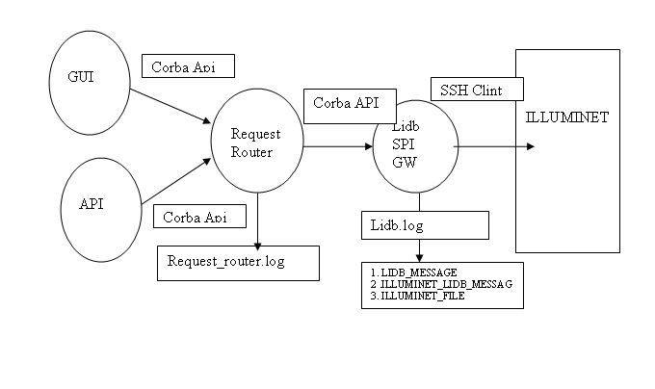
LIDB Verisign Process flow

Slide 9
Database Information
LIDB_MESSAGE (Contains lidb requests)
ILLUMINET_LIDB_MESSAGE(contains batchfile)
ILLUMINET_FILE (contains information about the file status whether sent or not)

Slide 10
LIDB Verisign Responses
VeriSign does not send responses to LIDB requests and no responses are displayed in Clearinghouse Basic. If there are issues with a request that are submitted, VeriSign will contact directly to the customer.

Slide 11
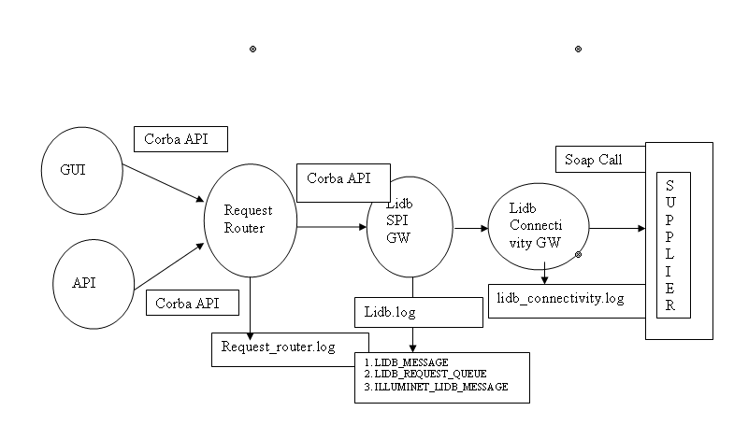
LIDB TNS Request Flow

Slide 12
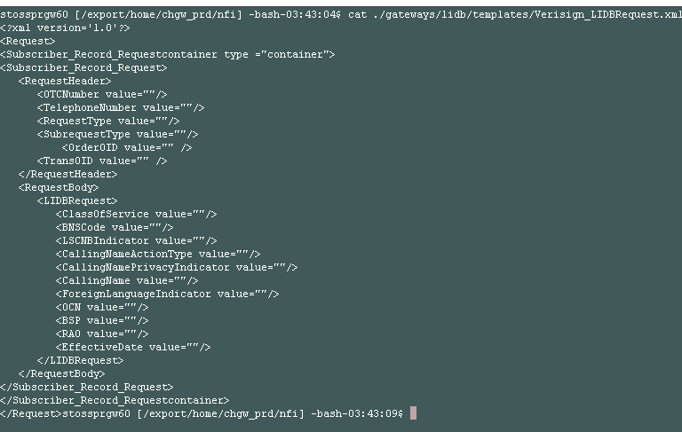

Slide 13
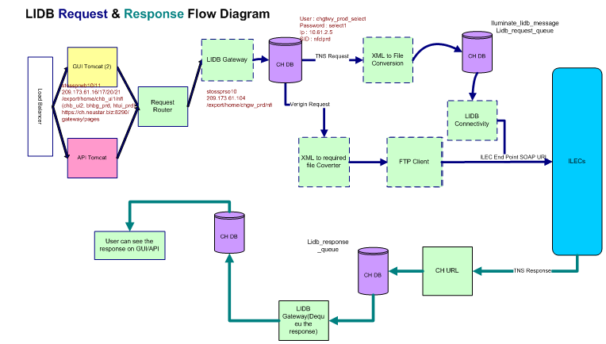

Slide 14
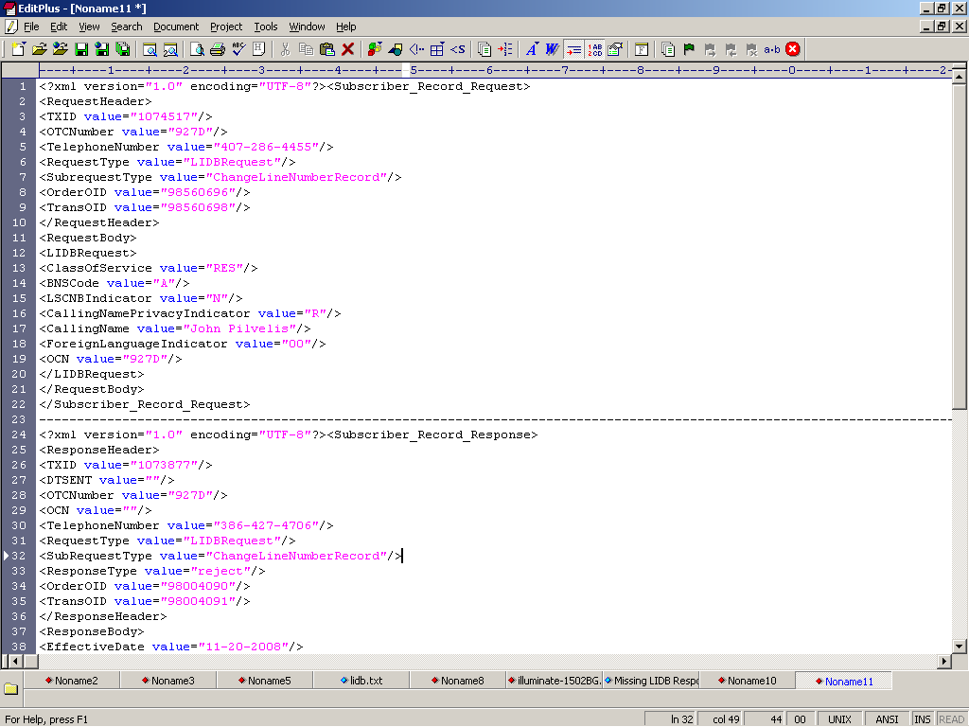

Slide 15
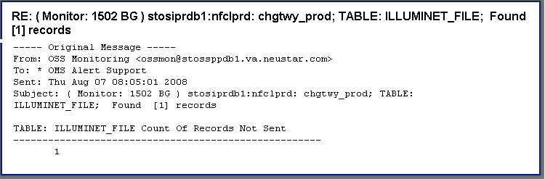
Alerts related to LIDB
1.1502 BG

Slide 16
Solutions provided
Login to chgtwy_prod database and check for the records in the illuminet_file table having status <> ‘Sent’
Take the filenames along with customerid.
Gather the information related to remote_ host,remote_dir, remote_username,password from the persistentproperty table with key=‘LIDB’ and customer the file it belongs to.
Check the logs and filename where it resides in the runtime folders at serverside.
By using the script(SCPScript.sh in ~/nfi/gateways/lidb /scripts) reflow it manually.
(Ex:/export/home/chgw_prd/nfi/gateways/lidb/scripts/SCPScript.sh Kr25d0g? /export/home/chgw_prd/nfi/gateways/lidb/ runtime /te mp/ SGCM2293 sigecom 198.202.216.23 . /export/home/chgw_prd/nfi /usr/bin/)

Slide 17
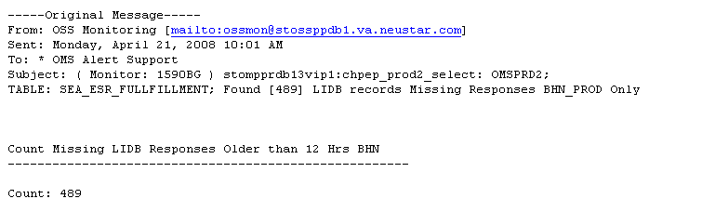
2. 1590BG (LIDB records missing responses)

Slide 18
Solution provided for 1590BG Alert
Login to production pep database (chpep_prod2@omsprd2)’s “sea_esr_fulfillment” table and collect records (transoids) that are having status=‘lidb_submitted‘.
i.e., select * from sea_esr_fulfillment where request_dt < sysdate - 1/2 and status = 'lidb_submitted';
Login to production basic gateway database (chgtwy_prod@nfclprd) ‘s “lidb_message” table and collect the telephone numbers by putting the transoids resulted from the production pep database’s sea_esr_fulfillment table.
i.e., select telephonenumber,created, requesttype, subrequesttype,transoid from lidb_message where transoid in (‘<transoid_list>’);
Open the production_basic_Secondary_ gateway server and in the nfi directory place the telephone numbers that are resulted from the ‘lidb_message’ query in the file called tn.txt
Take backup of reflowTool.log

Slide 19
..contd
Then reflow the telephone numbers by running the java program as follows
source setenv.sh
nohup java LIDBReflowTool /export/home/chgw_prd/nfi/tn/ https://206.66.146.147:443/axis/services/SOAPRequestHandler 2>&1 &
tail -f reflowTool.log
Arguments passed for the above java programme are file path (tn.txt) and soap_service_url which is configured in the persistentproperty.
Initialize the database, process the tn.txt file by taking TN[xxx-xxx-xxxx], ilec[TNS]and customerid[<CID>]
Sends the order using soa_service_soap and it will create a header and contact the server with the header and make message and send them one by one.
After completion it will close the database connection.

